Slide 1

QlikView
Data Analysis Tool
Business Data Analytics
By: Belal Khaled – 2136873

Slide 2

Topics:
Introduction
What is QlikView?
Data Types Used in QlikView
Advantages & Disadvantages
How Can We Use QlikView?

Slide 3

Introduction:
QlikView is a powerful business intelligence and data visualization tool developed by QlikTech.
It enables users to quickly and efficiently create interactive guided analytics applications and dashboards tailored to specific business challenges.
This tool is essential for organizations looking to gain insights from their data, enhance business operations, and boost overall productivity.

Slide 4

What is QlikView?
QlikView is a business intelligence and data visualization tool that allows users to create guided analytics applications as well as dashboards designed for business challenges.
Background:
Developed by QlikTech, it helps in simplifying data analysis and making insightful decisions.

Slide 5



Data Types Used In QlikView:
Numeric
Textual
Date Data
Best Data Type:
Numeric

Slide 6




Advantages:
User-Friendly Interface
In-memory Processing
Associative Model

Slide 7



Disadvantages:
Cost
Complexity in Scalability
Learning Curve

Slide 8

How Can We Use QlikView?
Let’s dive in

Slide 9
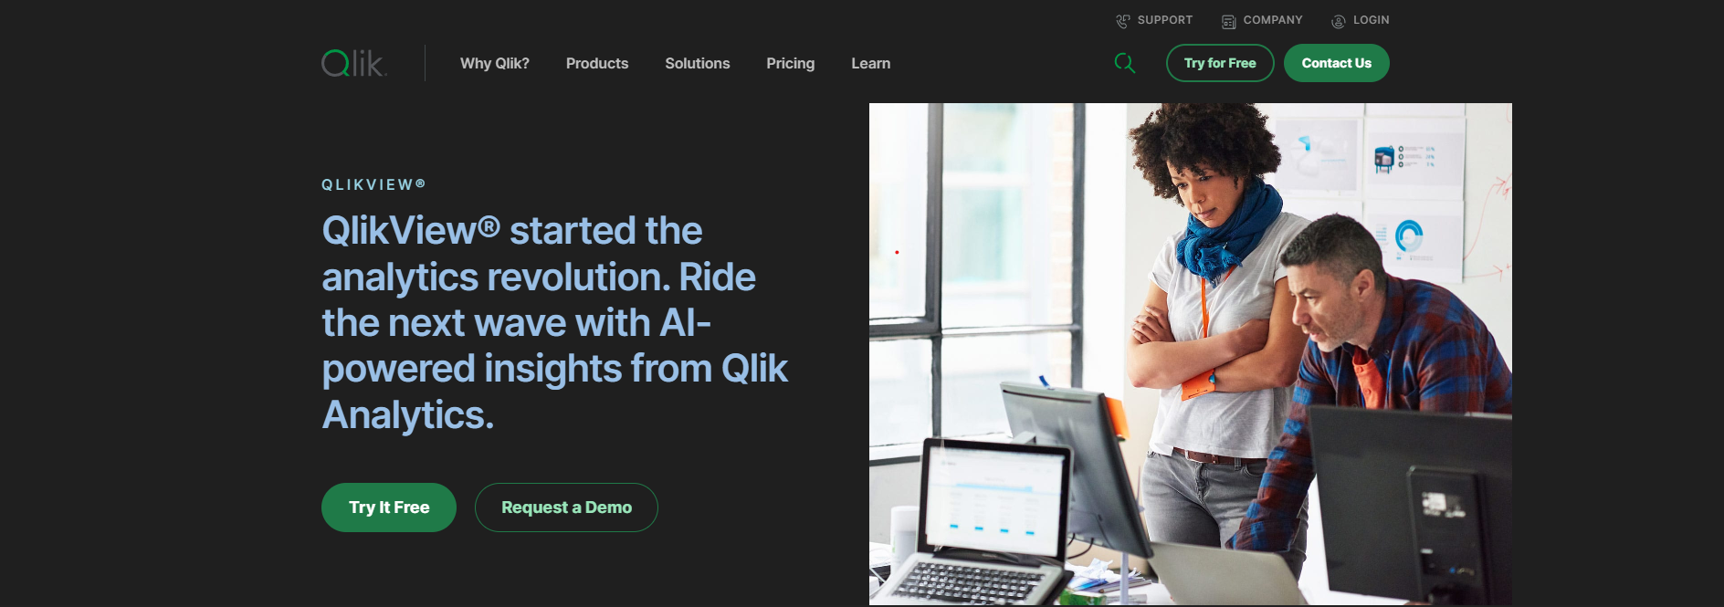
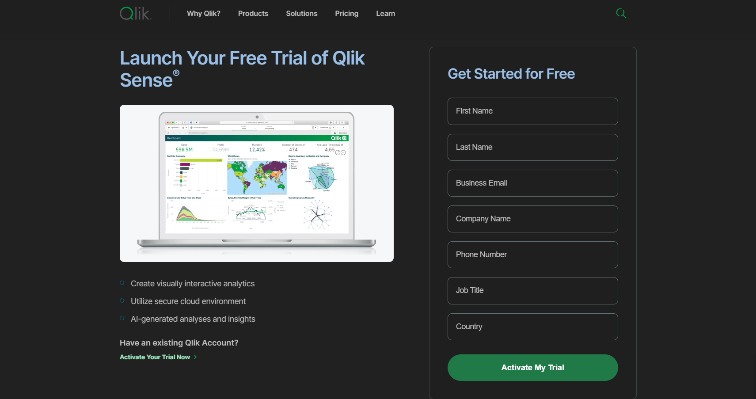
2
Fill your information's
1
3

Slide 10
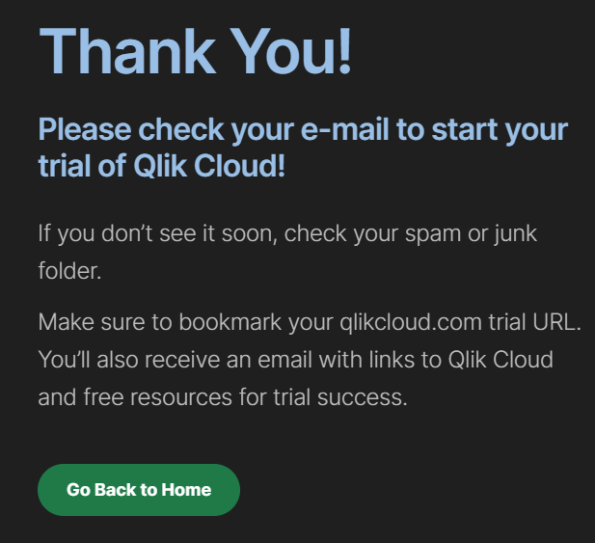
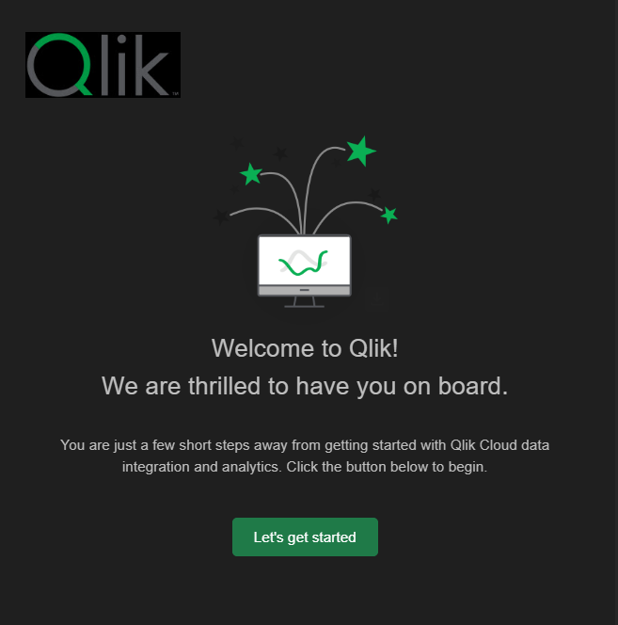
4

Slide 11
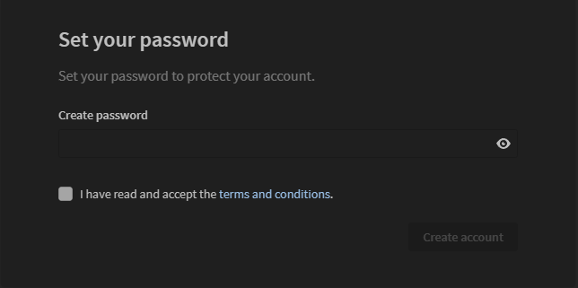
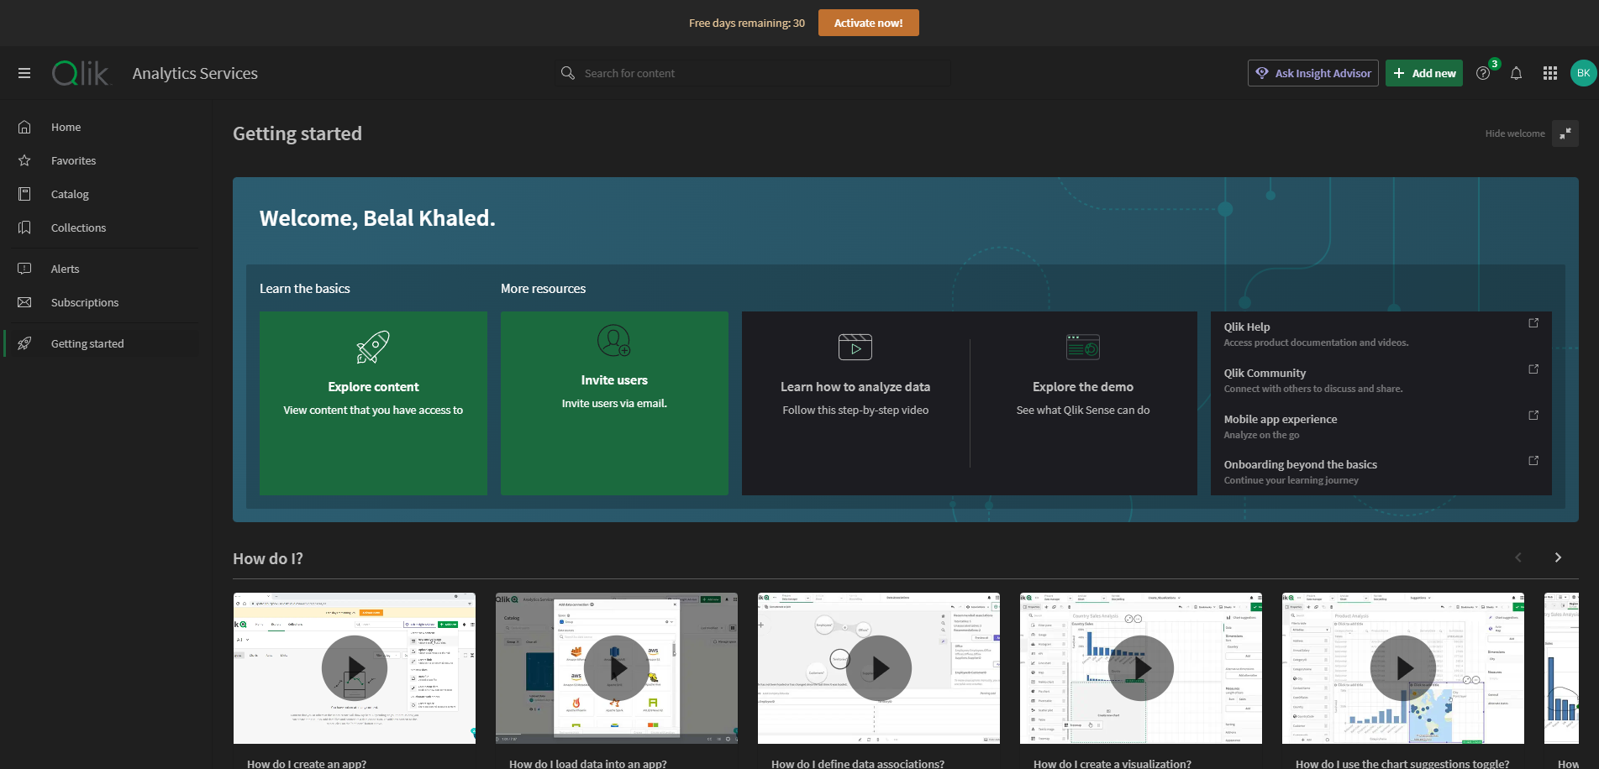
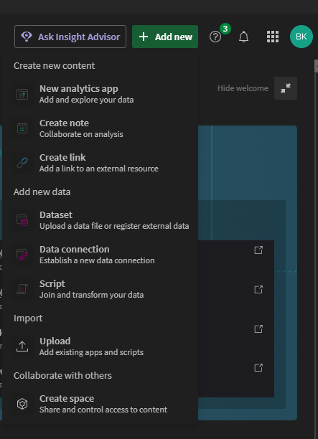
5
6
7

Slide 12
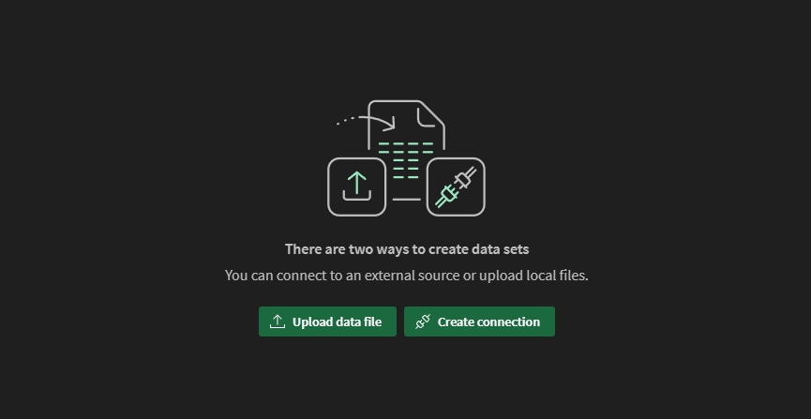
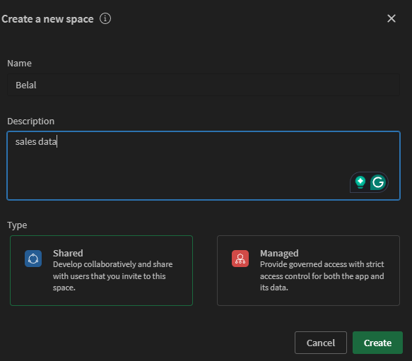
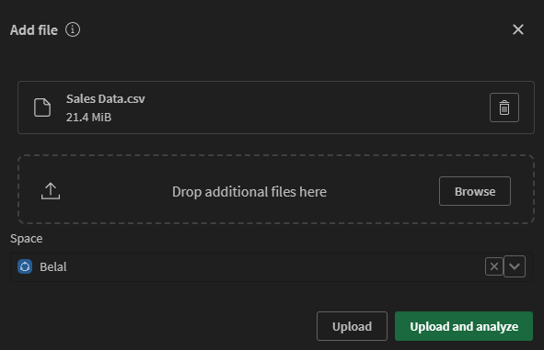
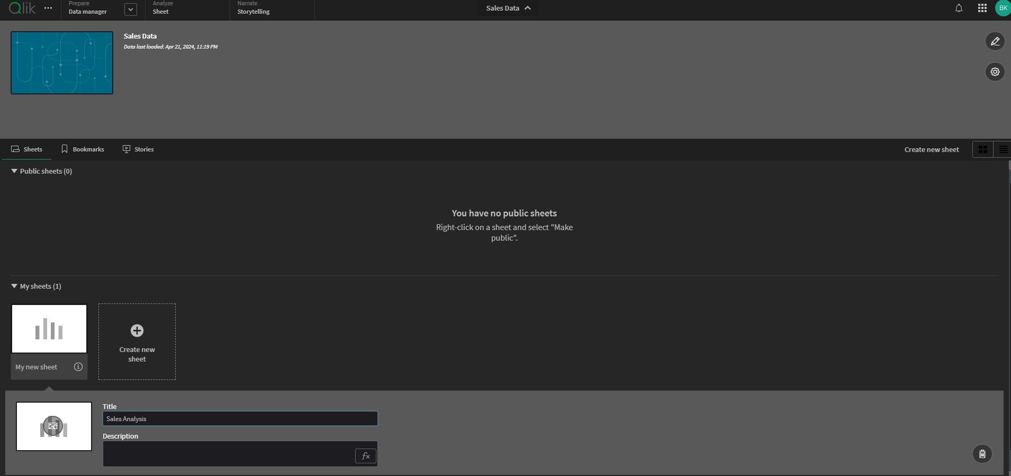
9
➔
➔
8
10
12
11

Slide 13
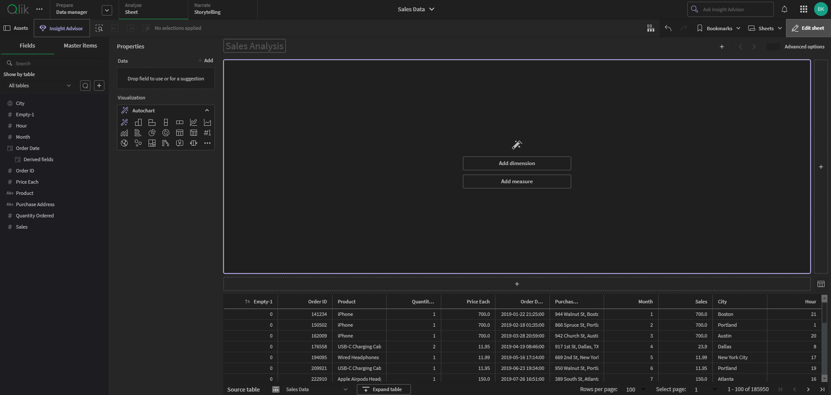
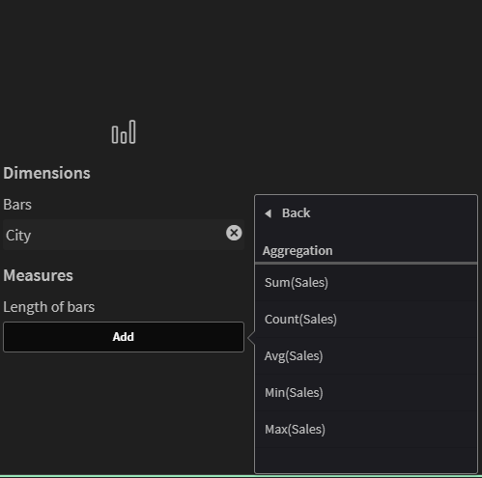
13
14
Set dimension for: City
Set measure for: Sum(Sales)

Slide 14
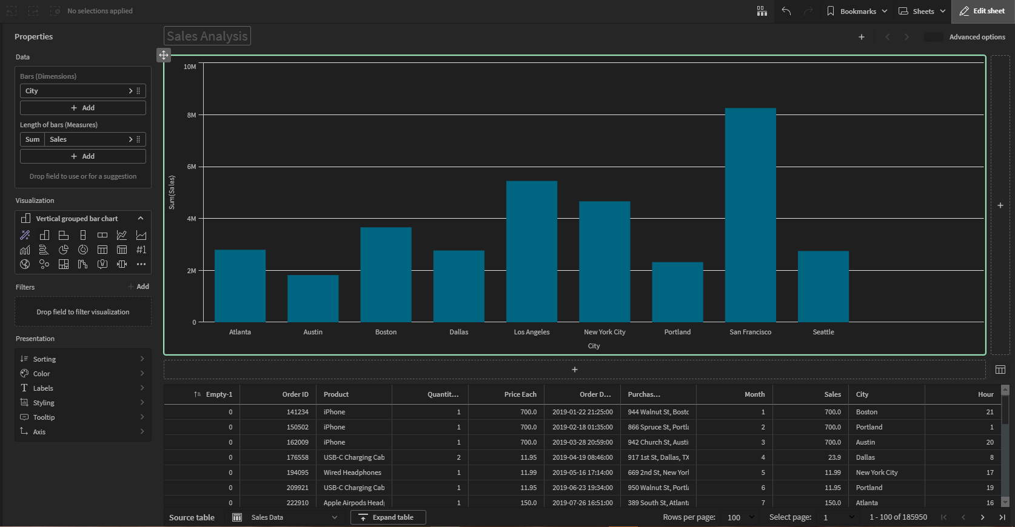
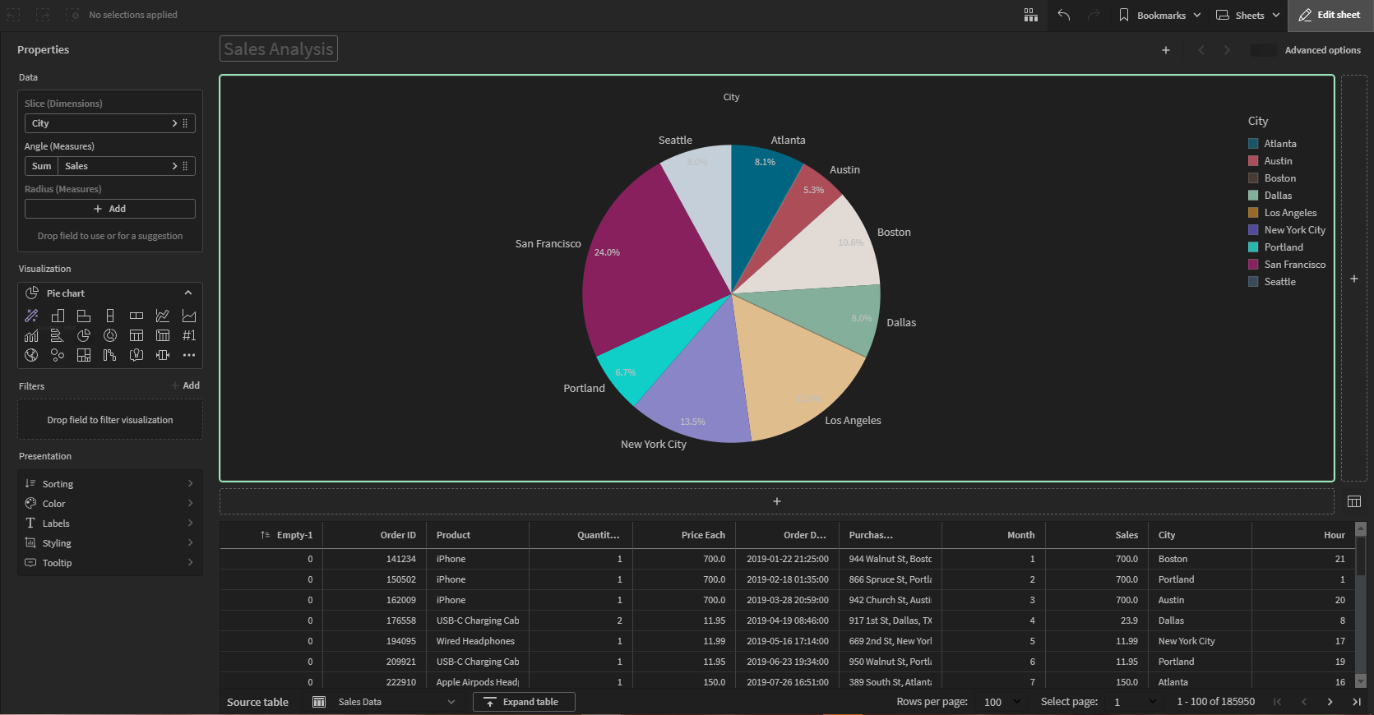
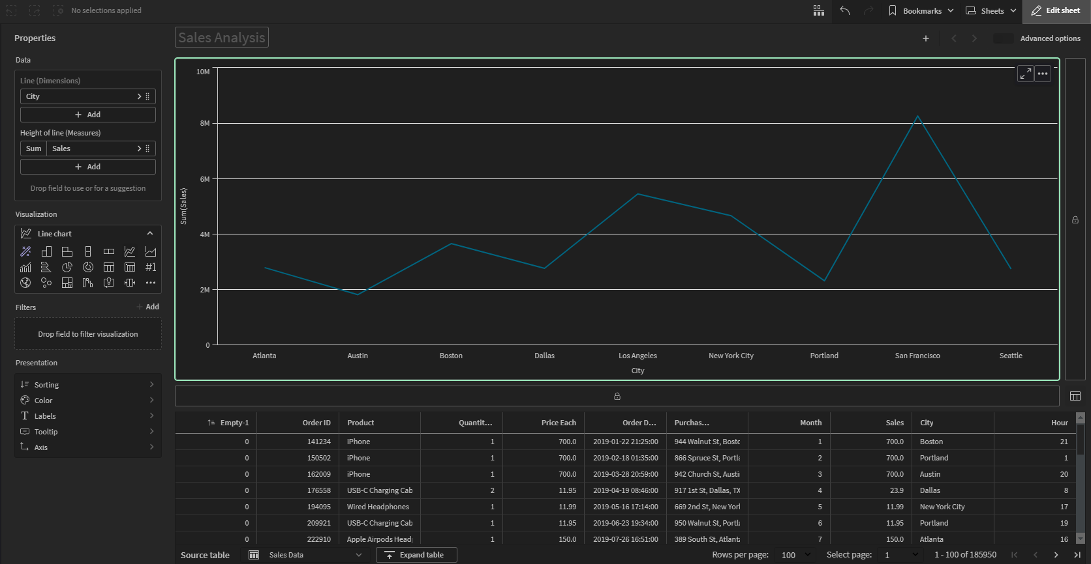
Bar Chart
Pie Chart
Line Chart

Slide 15

Thanks For Listening
Goodbye ☻

